Slide 1



LLM
SciBERT
A SCIENTIFIC BERT
By Sai Darshan

Slide 2

CONTENT
01
INTRODUCTION
02
KEY FEATURES
03
HOW IT WORKS?
04
APPLICATIONS
05
COMPARISON
06
PROS AND CONS
07
CONCLUSION

Slide 3
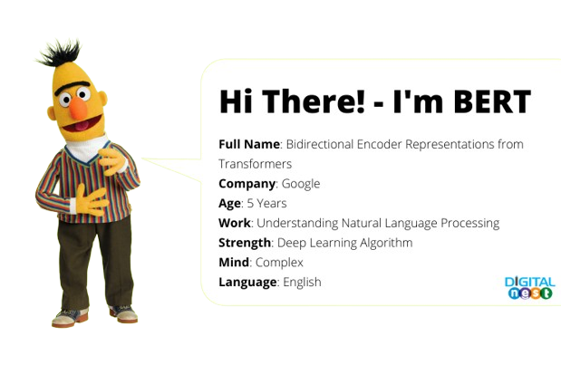

INTRODUCTION
A variant of BERT (Bidirectional Encoder Representations from Transformers) designed specifically for scientific text.
Developed by: Allen Institute for AI.
Purpose: Enhances NLP tasks involving scientific literature, such as document similarity, text classification, and named entity recognition.

Slide 4






KEY FEATURES
Pre-trained on Scientific Text
Custom Vocabulary
Uncased Version
Trained on a large corpus from the Semantic Scholar database.
Does not distinguish between uppercase and lowercase letters, reducing noise.
Includes scientific terminology for better representation of domain-specific language.

Slide 5

HOW IT WORKS?
TRANSFORMER ARCHITECTURE
FINE-TUNING
EMBEDDINGS
Utilizes self-attention to capture relationships between words in a context-aware manner.
Converts text into high-dimensional vectors that represent the semantic meaning of sentences.
Can be adapted for specific tasks by training on labeled datasets.

Slide 6
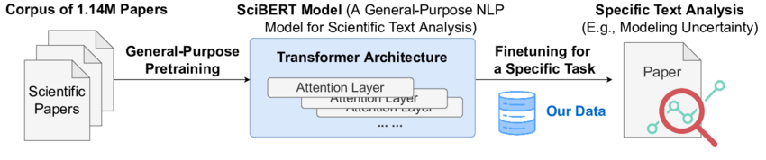
HOW IT WORKS?
Workflow for Scientific Text Analysis Using SciBERT

Slide 7

APPLICATIONS
Document Similarity: Measures similarity between scientific documents, aiding literature reviews and recommendations.
Text Classification: Categorizes research papers based on topics or research types.
Named Entity Recognition: Extracts relevant entities, such as author names and publication dates.
Question Answering: Retrieves information based on user queries about scientific texts.

Slide 8
PROS & CONS
Pros
Cons
Domain-Specific Pre-training
High-Quality Embeddings
Robustness to Noisy Data
Transfer Learning Capabilities
Community and Research Backing.
Computationally Intensive
Domain-Specific Limitations
Fine-Tuning Required
Model Size and Complexity
Potential for Overfitting

Slide 9

Conclusion
Significance: Represents a significant advancement in processing scientific literature.
Future Implications: Tools like SciBERT will play a crucial role in enhancing information retrieval as scientific research grows.

Slide 10














THANK YOU VERY MUCH!

